Slide 1

UNIT-1
Environments and Store
Prepared By:
Dr. Archana Sharma
archana@delhitechnicalcampus.ac.in

Slide 2
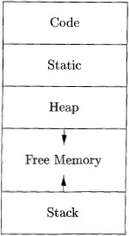
Run-Time Environments
Storage Organization

Slide 3
Storage Organization
Static vs. Dynamic Allocation
Static: Compile time, Dynamic: Runtime allocation
Many compilers use some combination of following
  Stack storage: for local variables, parameters and so on
  Heap storage: Data that may outlive the call to the procedure that created it
Stack allocation is a valid allocation for procedures since procedure calls are nested

Slide 4
Storage Organization
Activation records
Procedure calls and returns are usually managed by a run-time stack called the control stack.
Each live activation has an activation record (sometimes called a frame)
The root of activation tree is at the bottom of the stack
The current execution path specifies the content of the stack with the last
activation has record in the top of the stack.

Slide 5
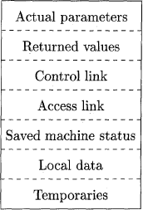
Stack Allocation of Space
A General Activation Record

Slide 6
Stack Allocation of Space
Activation Record
Temporary values
Local data
A saved machine status
An “access link”
A control link
Space for the return value of the called function
The actual parameters used by the calling procedure

Slide 7
Access to Nonlocal Data on the Stack
Designing Calling Sequences
Values communicated between caller and callee are generally placed at the beginning of callee’s activation record
Fixed-length items: are generally placed at the middle
Items whose size may not be known early enough: are placed at the end of activation record
We must locate the top-of-stack pointer judiciously: a common approach is to have it point to the end of fixed length fields.

Slide 8
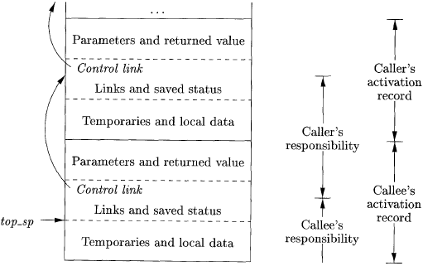
Access to Nonlocal Data
on the Stack
Division of tasks between caller and callee

Slide 9
Access to Nonlocal Data on the Stack
calling sequence
The caller evaluates the actual parameters
The caller stores a return address and the old value of top-sp into the callee's activation record.
The callee saves the register values and other status information.
The callee initializes its local data and begins execution.

Slide 10
Access to Nonlocal Data on the Stack
corresponding return sequence
The callee places the return value next to the parameters
Using information in the machine-status field, the callee restores top-sp and other registers, and then branches to the return address that the caller placed in the status field.
Although top-sp has been decremented, the caller knows where the return value is, relative to the current value of top-sp; the caller therefore may use that value.

Slide 11
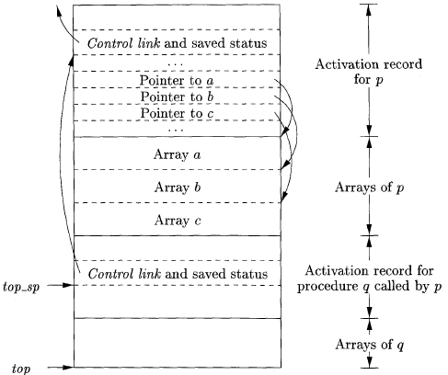
Access to Nonlocal Data on the Stack
Access to dynamically allocated arrays

Slide 12
HEAP MANGEMENT
HEAP ALLOCATION
Variables local to a procedure are allocated and de-allocated only at runtime.
Heap allocation is used to dynamically allocate memory to the variables and claim
it back when the variables are no more required.
Except statically allocated memory area, both stack and heap memory can grow and shrink dynamically and unexpectedly. Therefore, they cannot be provided with a
14
fixed amount of memory in the system.

Slide 13
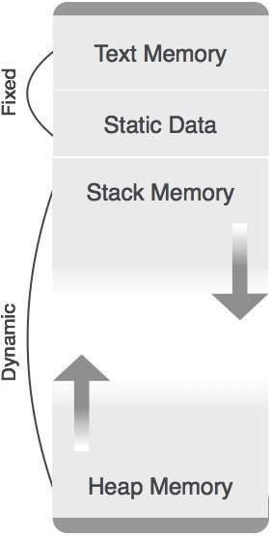
HEAP MANGEMENT
HEAP ALLOCATION

Slide 14
HEAP MANGEMENT
HEAP ALLOCATION
As shown in the image above, the text part of the code is allocated a fixed amount of memory.
Stack and heap memory are arranged at the extremes of total memory allocated to
the program.
Both shrink and grow against each other.
Parameter Passing
The communication medium among procedures is known as parameter passing. The values of the variables from a calling procedure are transferred to the called procedure by some mechanism.

Slide 15
HEAP MANGEMENT
HEAP ALLOCATION
Before moving ahead, first go through some basic terminologies pertaining to
the values in a program.
r-value
The value of an expression is called its r-value. The value contained in a single variable also becomes an r-value if it appears on the right-hand side of the assignment operator. r-values can always be assigned to some other variable.
l-value
The location of memory (address) where an expression is stored is known as the l-value of that expression. It always appears at the left hand side of an assignment operator.

Slide 16
HEAP MANGEMENT
HEAP ALLOCATION
For example:
day = 1; week = day * 7; month = 1; year = month * 12;
From this example, we understand that constant values like 1, 7, 12, and
variables like day, week, month and year, all have r-values.
Only variables have l-values as they also represent the memory location assigned to them.
For example:
7 = x + y;
is an l-value error, as the constant 7 does not represent any memory location.

Slide 17
Garbage collection
Garbage collection Definition
Garbage collection (GC) is a dynamic approach to automatic memory management and heap allocation that processes and identifies dead memory blocks and reallocates storage for reuse.
The primary purpose of garbage collection is to reduce memory leaks.
GC implementation requires three primary approaches, as follows:
Mark-and-sweep - In process when memory runs out, the GC locates all accessible memory and then reclaims available memory.

Slide 18
Garbage collection
Garbage collection Definition
Reference counting - Allocated objects contain a reference count of the referencing number.
When the memory count is zero, the object is garbage and is then destroyed. The freed memory returns to the memory heap.
Copy collection - There are two memory partitions.
If the first partition is full, the GC locates all accessible data structures and copies them to the second partition, compacting memory after GC process
.and allowing continuous free memory

